Slide 1
Threads in JAVA

Slide 2
Thread
Java provides
Built-in support for multithreaded programming
Multithreading is a feature that allows
Concurrent execution of two or more parts of a program
For maximum utilization of CPU
Each part of such a program is called
A thread, and each thread defines a separate path of
execution
** A thread in Java, is the path followed when executing a program

Slide 3
Thread
When a Java program starts up
One thread begins to run immediately
Usually called the main thread of the program because
It is the one that is executed when our program begins
Properties of main thread
It is the thread from which other “child” threads will be
produced
Often, it must be the last thread to finish execution
because it performs various shutdown actions

Slide 4
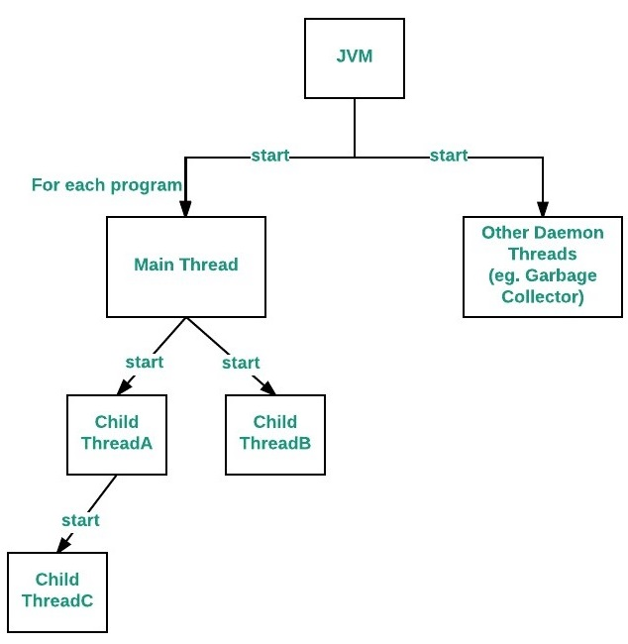
Thread
To control a thread
It we must obtain a reference to it
Done by calling the method currentThread( ) present in Thread
class
This method returns a reference to the thread on which it is called

Slide 5
Relation between the main() method and main thread in Java
For each program
A Main thread is created by JVM (Java Virtual Machine)
Which first verifies the existence of the main() method and
Then it initializes the class
** Note that from JDK 6, main() method is mandatory in a
standalone java application

Slide 6
Thread Priority
When a thread is created
It inherits its priority from the thread that created it
Normally, the thread priority will be 5
A thread’s priority
Can be modified at any time after its creation
Using the setPriority () method
Thread priorities are integers ranging between
MIN_PRIORITY (i.e., 1) and
MAX_PRIORITY (i.e., 10)
The higher the value (integer)
The higher the priority
\
The default priority of Main thread is 5 and for all remaining user threads, priority will be inherited from parent to child

Slide 7
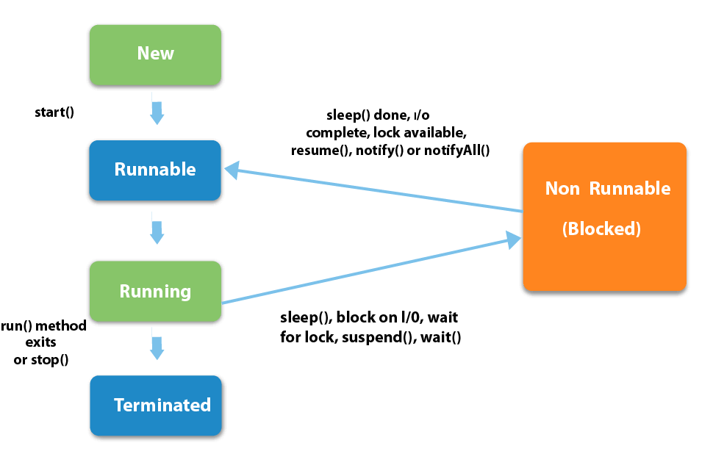
Life cycle of a Thread
A thread in JAVA, at any point of time
Lies only in any one of the following states as given
below:

Slide 8
Life cycle of a Thread
New
When a new thread is created, it is in the NEW state
It remains in this state until
The program starts the thread using its start () method
At this point, thread is not alive and it’s a state internal to Java programming
The start() method creates
The system resources necessary to run the thread
Schedules the thread to run,
Etc.

Slide 9
Life cycle of a Thread
Runnable
Calling start () method on thread put it in RUNNABLE state
At this point, execution control is passed to thread scheduler
to finish its execution
Thread scheduler decides from which point of time, a thread
should be executed (also known as dispatching the thread)
The operating system allocates each thread a small amount
of processor time, called a quantum or timeslice
To perform its task
A thread utilizing its quantum is said to be in Running
State
When its quantum expires, the thread returns to the
RUNNABLE state
The process uses to determine which thread to dispatch
depending on its priority is called thread scheduling

Slide 10
Life cycle of a Thread
Running
When a thread is executing, its state is changed to
RUNNING state
Thread scheduler picks one of the threads from the
runnable thread pool and the CPU starts executing this thread
A thread can change state to Runnable, Dead or Blocked from running state depends on
Time slicing
Completion of run() method or
Waiting for some resources

Slide 11
Life Cycle of a Thread
Blocked / Waiting (Non-Runnable)
A RUNNABLE thread enters into the BLOCKED state when
It attempts to perform a task that cannot be completed
immediately and it must temporarily wait to complete that task as something else needs to be done prior to what current thread is doing
A thread can be put into the TIMED WAITING state if
It is provided an optional wait interval when waiting for
another thread to perform a task
A Non-Runnable thread returns to the RUNNABLE state when
It’s notified by another thread or when the timed interval
expires, whichever comes first

Slide 12
Life cycle of a Thread
Terminated
A thread enters the TERMINATED state (or the dead state)
when
It successfully completes its task or
Terminated due to any error or
It was forcefully killed

Slide 13
Thread Scheduling
When a single CPU executes multiple threads in some order, is called scheduling
In general, the runnable thread with the highest priority becomes active (running)
JAVA is priority-preemptive i.e.,
If a high-priority thread wakes up when a low-priority thread is running, then the high-priority thread gets into the running immediately

Slide 14
Thread Scheduling
Types of scheduling
Waiting and Notifying
Waiting [wait ()] and notifying [notify (), notifyAll ()]
provides means of communication between threads that
synchronize on the same object
When wait () method is invoked on an object, the thread
executing that code gives up its lock on the object
immediately and moves the thread to the waiting state
Notify () method wakes up threads that called wait () on the
same object and moves the thread to ready state
notifyAll () wakes up all the threads that called wait () on
the same object

Slide 15
Thread Scheduling
Running and Yielding
Yield () can stop the currently executing thread and
Will give a chance to other waiting threads of the same
priority

Slide 16
Thread Scheduling
Sleeping and Waking up
Sleep () is used to pause a thread for a specified period of
time before moving it to runnable state again

Slide 17
Creating a Thread
Threads can be created in two ways:
Extending the Thread class
Implementing the Runnable Interface

Slide 18
Creating a Thread Extending the Thread class
In this method
A class is created by extending the Thread class
This class overrides the run () method available in the
Thread class
An object of the new class is created and the start ()
method is called to start the execution of the thread
Start () invokes the run () method on the Thread object

Slide 19
Example program Thread creation by extending the Thread
class Thread_class extends Thread // Extending Thread class { public void run() { try { // Displaying the thread that is running System.out.println ("Thread " + Thread.currentThread().getId() + " is running"); } catch (Exception e) { System.out.println ("Exception: " + e); } } } | public class Thread_ex_1 { public Thread_ex_1() { Thread_class th = new Thread_class (); th.start(); } public static void main(String[] args) { Thread_ex_1 tex1 = new Thread_ex_1(); } } Output :: Thread 10 is running

Slide 20
Creating a Thread By implementing the Runnable Interface
In this method of thread creation
A new class implements Runnable interface
Which overrides run () method
Then, a Thread object is instantiated and
Call start () method on this object

Slide 21
Creating a Thread By implementing the Runnable Interface
class Thread_class implements Runnable { public void run() { try { // Displaying the thread that is running System.out.println ("Thread " + Thread.currentThread().getId() + " is running"); } catch (Exception e) { System.out.println ("Exception :: " + e); } } } | class Thread_ex_2 // Main Class { public Thread_ex_2() { Thread th = new Thread(new Thread_class()); th.start(); } public static void main(String[] args) { Thread_ex_2 tex2 = new Thread_ex_2(); } } Output :: Thread 10 is running

Slide 22
Thread Class Vs Runnable Interface
If a class extend the Thread class as the base
That class cannot extend any other class But, if the Runnable interface is implemented by a class, then
That class can still extend some other relevant base classes
Some basic functionality of a thread can be achieved by extending Thread class because
It provides some inbuilt methods like yield(), interrupt() etc. that are not available in Runnable interface

Slide 23
Thread Synchronization

Slide 24
Example::Need of Thread Synchronization
Suppose we have two different threads, T1 and T2
T1 starts execution and save certain values in temporary.txt
Which will be used by T1 later to calculate some result
Meanwhile, T2 starts before T1 returns
T2 changes the values saved by T1 in temporary.txt
Now obviously T1 will return wrong result
To prevent such problems
Synchronization was introduced
With synchronization in above case
Once T1 starts using temporary.txt file
This file will be locked (LOCK mode), and
No other thread will be able to access or modify it
Until T1 returns

Slide 25
Thread Synchronization
When more than one thread try to access a shared resource
It need to ensure that
The resource will be used by only one thread at a time
Otherwise, it will lead to distorted results
Synchronization
A process of handling resource accessibility when multiple threads request for the same resource
The main purpose is to avoid thread interference
The synchronized keyword in java creates a block of code referred to as critical section
Every Java object with a critical section of code
Gets a lock associated with the object
To enter critical section
A thread need to obtain the corresponding object's lock

Slide 26
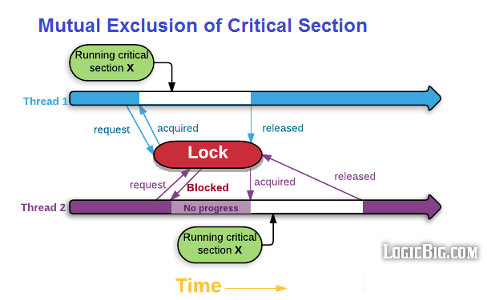
Need of Thread Synchronization

Slide 27
Thread Synchronization
The synchronization is mainly used to
To prevent thread interference
To prevent consistency problem
How to achieve thread synchronization in Java ?
Two types of thread synchronization
Mutual Exclusive
Synchronized method
Synchronized block
Inter-Thread communication (Co-operation)

Slide 28
Thread Synchronization
An example without thread synchronization
Output required ::
[welcome to] Java Programming Class]

Slide 29
Thread Synchronization
class Print { public void display(String msg) { System.out.print ("[" + msg); try { Thread.sleep(1000); } catch(InterruptedException e) { e.printStackTrace(); } } System.out.println ("]"); } } | class Thread_x extends Thread { String msg; Print p_obj; Thread_x (Print pr, String str) { p_obj = pr; msg = str; } public void run() { p_obj.display(msg); } }
public class Synchronization_Thread_1 { public static void main (String[] args) { Print pr_obj = new Print (); Thread_x T1 = new Thread_x (pr_obj, "welcome to "); T1.start(); Thread_x T2 = new Thread_x (pr_obj, “Java Programming class"); T2.start(); } } Output :: [welcome to [Java Programming class ] ]

Slide 30
Thread Synchronization
In this example
Object pr_obj of class print is shared by
The two running threads (T1and T2)
To call the shared method (void display)
Hence the result is non-synchronized
Such situation is called Race condition

Slide 31
Thread Synchronization Using Synchronized Method
To synchronize above program
Synchronize access to the shared display() method by
Making it available to only one thread at a time
This can be done
By using keyword synchronized with display() method
public synchronized void display (String msg)

Slide 32
Thread Synchronization Using Synchronized Block
To synchronize access to an object of a class or
Only a part of a method to be synchronized
The synchronized block can to be used
It is capable to make
Any part of the object and method synchronized

Slide 33
Thread Synchronization Using Synchronized Method
class Print { public synchronized void display(String msg) { System.out.print ("[" + msg); try { Thread.sleep(1000); } catch(InterruptedException e) { e.printStackTrace(); } } System.out.println ("]"); } } | class Thread_x extends Thread { String msg; Print p_obj; public Thread_x(Print pr, String s) { p_obj = pr; msg = s; } public void run() { p_obj.display(msg); } }
public class Synchronization_Thread_1 { public static void main (String[] args) { Print pr_obj = new Print(); Thread_x T1 = new Thread_x (pr_obj, "welcome"); T1.start(); Thread_x T2 = new Thread_x (pr_obj, "new programmer"); T2.start(); } } Output :: [welcome to][Java Programming class]

Slide 34
Thread Synchronization Using Synchronized Block
class Print { public void display(String msg) { System.out.print ("[" + msg); try { Thread.sleep(1000); } catch(InterruptedException e) { e.printStackTrace(); } } System.out.println ("]"); } } | class Thread_x extends Thread { String msg; Print p_obj; public Thread_x(Print pr, String s) { p_obj = pr; msg = s; } public void run() { synchronized(p_obj) { p_obj.display(msg); } } }
public class Synchronization_Thread_1 { public static void main (String[] args) { Print pr_obj = new Print(); Thread_x T1 = new Thread_x (pr_obj, "welcome"); T1.start(); Thread_x T2 = new Thread_x (pr_obj, "new programmer"); T2.start(); } } Output :: [welcome to][Java Programming class]

Slide 35
Thread Synchronization Difference between synchronized Method and synchronized block
Synchronized Method
It acquires a lock in the object for the whole method
It means that no other thread can use any synchronized method
until the current thread
Which has invoked it's synchronized method, has finished its
execution
Synchronized Block
Acquires a lock in the object only between parentheses after the
synchronized keyword
This means that no other thread can acquire a lock on the locked
object until the synchronized block exits.
But other threads can access the rest of the code of the method

Slide 36
Thread Synchronization Inter-Thread Communication
Java provide benefits of avoiding thread pooling
Using inter-thread communication
Thread pooling is usually implemented by loop
To check some condition repeatedly
Once condition is true, appropriate action is taken
Waste CPU time
For Inter-Thread Communication
The wait(), notify(), and notifyAll() methods of Object class are used
Implemented as final methods in Object
So that all classes have them
Can be called only from
Within a synchronized context

